Slide 1
Either before of after a question, it will be based on what the concept will be used, i.e. rabbit hole limitless questions or other
Based on desired results, i.e. if the user will be likely to buy hunting gear or wigs
name | race | age | location | ID | Political
A | 1 | 20 | abc | 1 | x
B | 2 | 30 | efg | 2 | y
C | 3 | 40 | hij | 1 | x
D | 4 | 50 | klm | 1 | x
E | 1 | 60 | nop | 3 | y
F | 2 | 50 | qrs | 2 | y
G | 3 | 40 | tuv | 1 | x
name
Article or video or picture
race
age
location
Gender ID
Politcal group
Question? Either yes or no answer or multiple choice
This was part of my proposal for my MVP

Slide 2
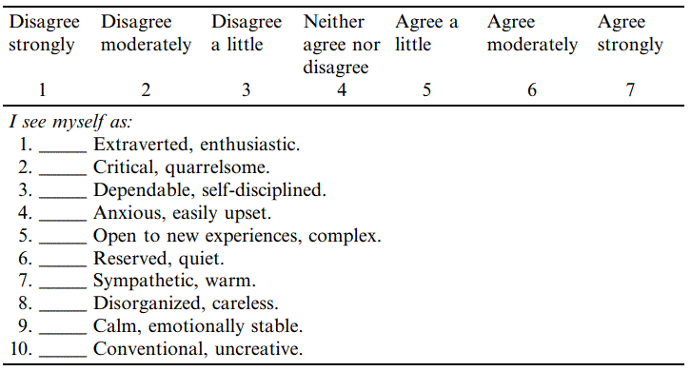
Page 1
Page 2
Page 3
Page 4
Please read and answer the following questions:
Politically I am:
Left, left moderate, moderate, right moderate, right?
do you drive a gas car? Y/N
Do you drive that car for financial reasons? Y/N
Would you buy and electric car? Y/N
Does Global Warming exist? Y/N
Does gas mileage of your vehicle concern you? Y/N
Do gas prices concern you? Y/N
Would you drive and electric car if affordable? Y/N
If this was for commercial purposes one of the proposed ideas, I must get return test takers is posting results on this page and see what or who they are compatible with. It doesn’t have t be right, but it just must get them to take another survey.
Name:
Age:
Race:
Income:
Zip code:
Income bracket: below 50k above 50 k, more than 100k
Car owner:
Make/Model:
Engine type Gas/electric:
Purchased car in the past five years: Y/N
Data collected here would be pushed to a survey that would then interpret the data. At the moment I am looking to implement Cronbach’s Alpha to generate the correlation data I am looking for.
UML for “Thoughts” application

